Slide 1
Virtual Roll Call
Team Member(s):
Ivana Rodriguez, Shalisha Witherspoon, Shonda Witherspoon Product Owner: Jason Cohen
Instructor: Masoud Sadjadi School of Computing and Information Sciences Florida International University
Final Presentation
Fall 2016
Notes:
7 seconds.
Greet your audience, thank them for attending your presentation, introduce yourself, introduce your project, introduce your team members, and quickly indicate what each of you did in a high-level manner, and put more emphasis on your part/contribution.

Slide 2

Introduction
Police Officers use a roll call system as a means to relay important information at the beginning of each shift. Unfortunately, many officers are sometimes unable to attend roll due to various circumstances such as traffic, court obligations, and early assignments. Virtual Roll Call was a solution deemed fit by the Pinecrest Police Department in order to allow officers to view information provided at roll call at their earliest convenience, without missing any vital information.
Virtual Roll Call is a web application that allows Supervisors to upload documents to the system, and Officers to view/download these documents. The application is completely customizable by Administrators, who can add/edit/delete users from the system, add categories to upload documents under, and change logo and the department name, so that other police departments can use the system in the future.
By having the roll call system virtualized, officers are always up to date on the latest briefings, and can carry out their tasks efficiently, which will be a great service to the community as a whole.
Notes:
intro/problem statement shalisha

Slide 3
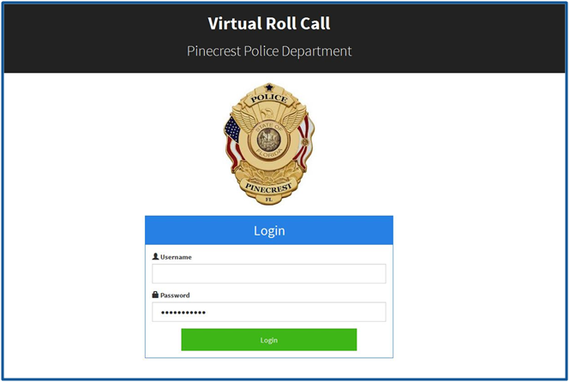
Project definition
Officers, Supervisors, and Administrators access the login page, and upon entering correct credentials, are routed to their appropriate dashboards in order to fulfill their tasks, and access role specific features.
Notes:
Shon
10 seconds.
Introduce the problem that the whole project (in all versions) tackles with GIF or screenshot.

Slide 4
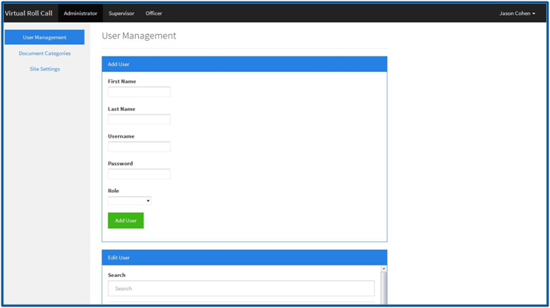
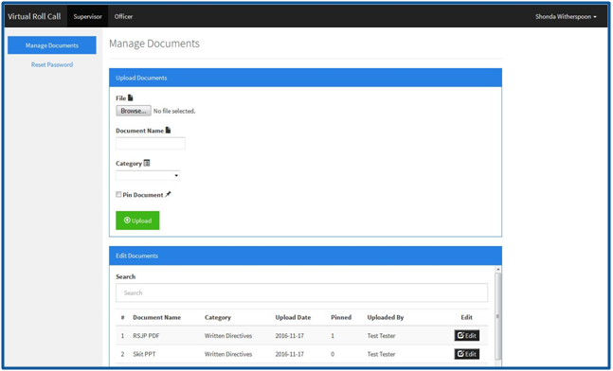
Administrator
Dashboard
Add/Edit/Delete users
Customize site settings
Add new categories
Supervisor
Dashboard
Upload documents
Reset user passwords
Notes:
Shon
10 seconds.
Introduce the problem that the whole project (in all versions) tackles with GIF or screenshot.

Slide 5
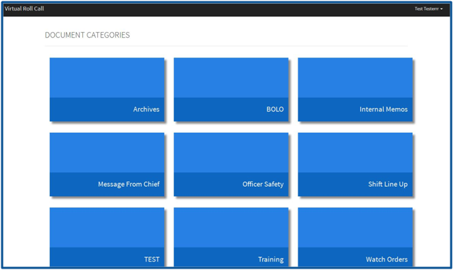
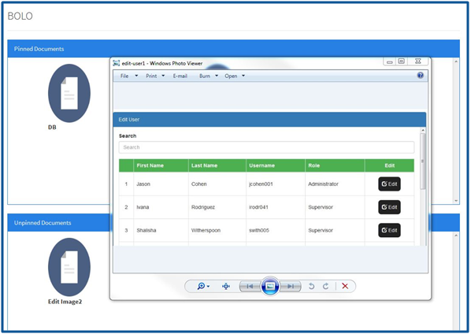
Officer Dashboard
View documents grouped by category
Notes:
Shon
10 seconds.
Introduce the problem that the whole project (in all versions) tackles with GIF or screenshot.

Slide 6
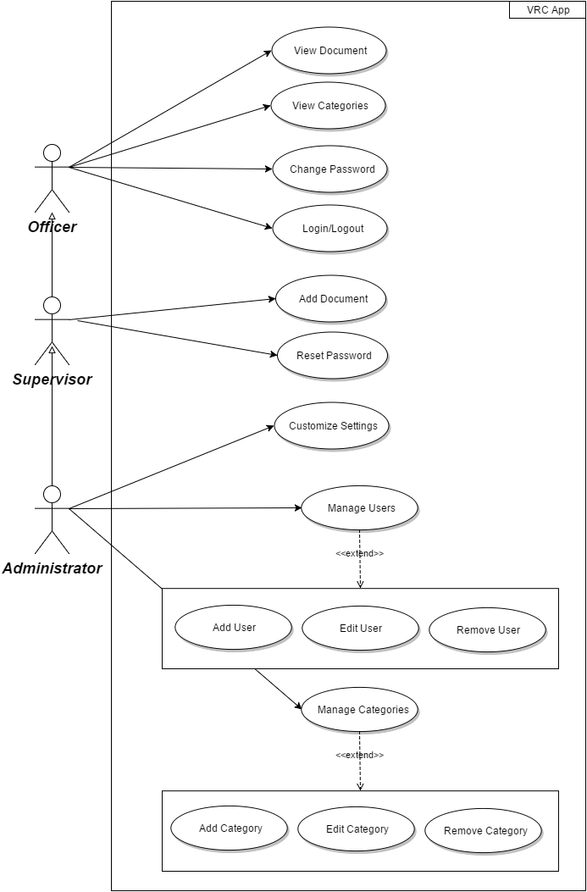
Requirements: Use Cases
Notes:
Show the Use Case Diagram for the whole project. Highlight your use cases.

Slide 7
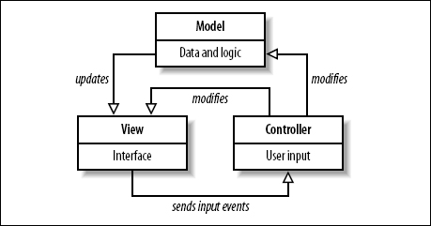
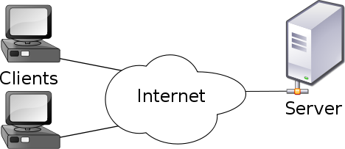
System Design: Architecture
Model-View Controller
Model-View-Controller is an architectural pattern commonly used for designing web applications. As the name implies, there are 3 major components in the architecture:
1. Model – manages the data and logic of the application
2. View – The User Interface of the application
3. Controller – Receives user input and modifies data in the model
Client-Server Model
Our system uses the Client-Server model, which is an application structure used in distributed applications. The client makes requests to the server via the internet,, and the server responds to the client with the requested function.. Virtual Roll Call is hosted on a Linux Ubuntu virtual machine, and clients are able to use the application and perform actions through the server.
Notes:
Shon (ER), Shalisha (MVC, Lamp)
System design: Highlight the parts that you contributed to them.
1. System decomposition; identify the architecture patterns used
2. System deployment – h/w and s/w requirements

Slide 8
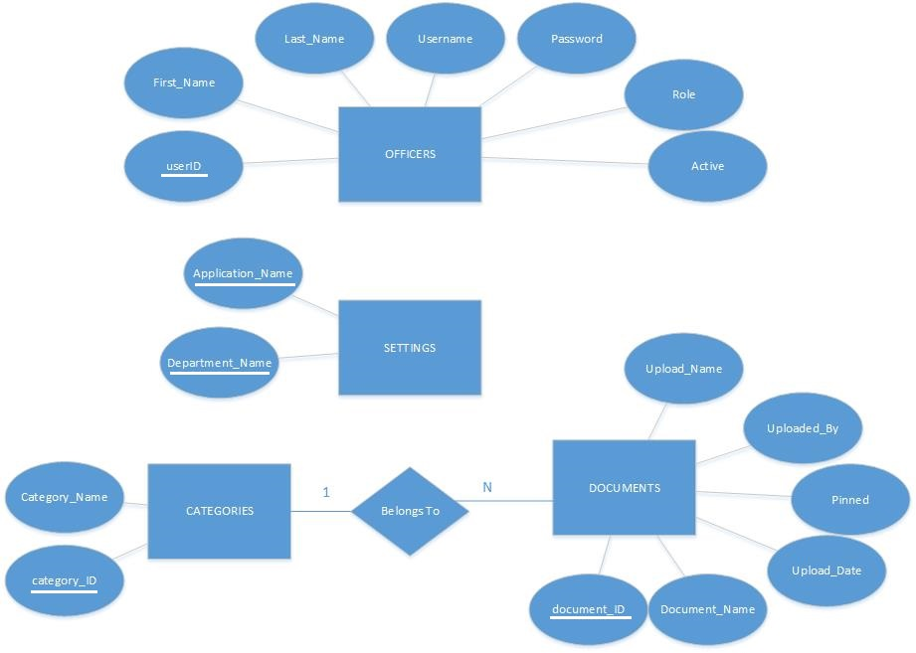
ER Diagram

Slide 9
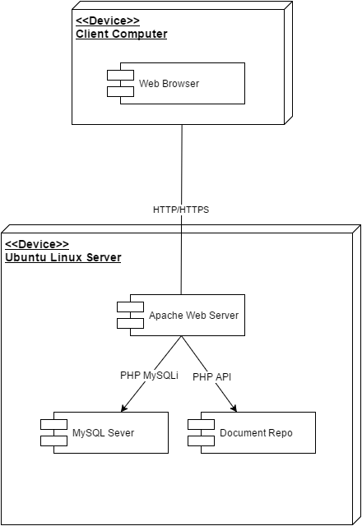
System Design: Deployment

Slide 10
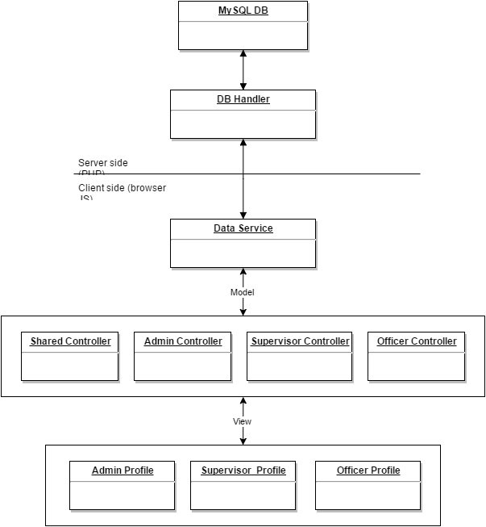
Minimal Class Diagram
Notes:
10 seconds.Minimal class diagram. Highlight the classes that you created/modified
Identify the design patterns used (one or more slides).

Slide 11
User Stories
Create User Login
Add User
Change Password
Edit User
Remove User
Reset Password
Add Category
Add Document
Edit Category
Remove Category
Upload Document
Customize Site Settings
List Pinned Documents
List Unpinned Documents
View Categories
View Document
Notes:
(Everyone works on their user stories)
5 seconds.
List the user stories that you worked on them. (put in order of importance). Stay focused on the parts that you have been working.

Slide 12
User Story #1 - Create User Login
As a user, I would like the ability to login to my role-based view of the application so that I can access the system.
Actor | Officer, Supervisor, Administrator
Details | Users with appropriate credentials can access the system and be routed to their appropriate view
Entrance Condition | 1. User role is Officer, Supervisor, or Administrator 2. User enters their username and password
Exit Condition | 1. User credentials are valid, and are routed to their appropriate role based view
Sequence | 1. Use case begins when a user enters their username and password in the login form 2. User presses the login button 3. If credentials are valid, user is granted access to the system, and is routed to a page dependent on their role
Notes:
60 seconds
The tile of user story
The most important user story you worked on it. You have to describe this one very well and be proud of that.
Please present and show the complexity of your work, code, algorithms, and technical challenges and technologies you have used. (you could use screenshot if you want. Visual presentations are better than text presentation)
Go into the details of the most important/significant tasks using bullet lists or visual graphs or state chart diagram
Sequence Diagram for this user story is mandatory (in another separate page if required)
Demo using screenshots or GIF (in another separate page if required)

Slide 13
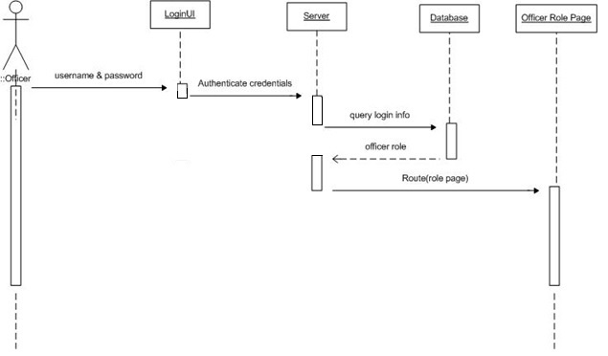
Sequence Diagram

Slide 14
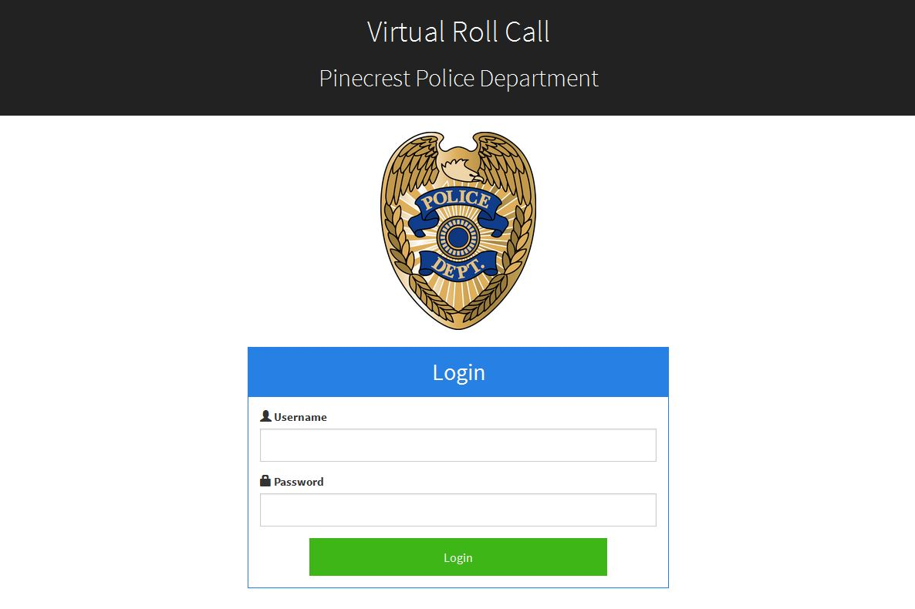
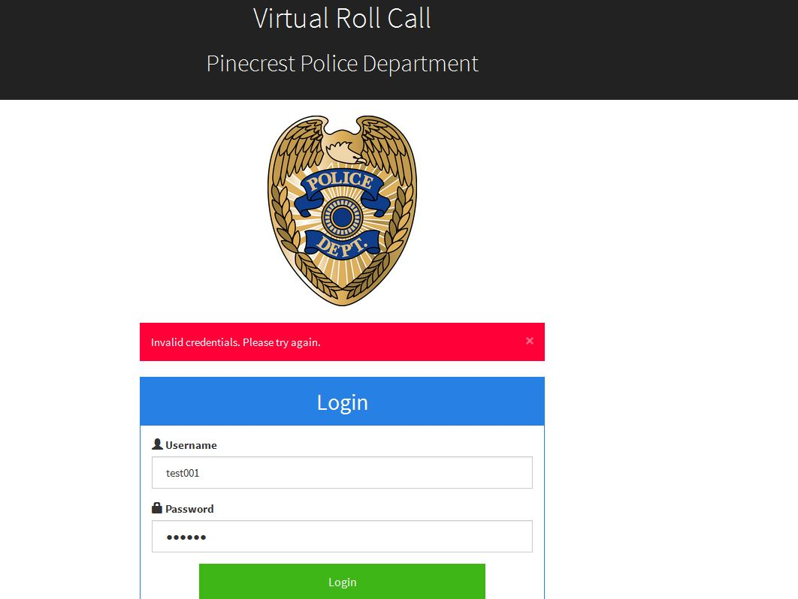

Slide 15
User Story #2 - Add User
As an administrator, I would like to be able to add other users to the database, so that they will have authentication to login to the system.
Actor | Administrator
Details | List pinned documents in the database (filtered by category)
Entrance conditions | User role is administrator and under Manage Documents view
Exit condition | User is successfully added to the database and provided login credentials
Sequence | 1. Use case begins when an Administrator logs into system 2. Administrator enters form data (all fields required) 3. Use case ends when administrator presses submit button
Related Use Cases | None
Notes:
20 seconds
The tile of user story
Please present and show the complexity of your work, code, algorithms, and technical challenges and technologies you have used. (you could use screenshot if you want. Visual presentations are better than text presentation) - Go into the details of the most important/significant tasks using bullet lists or visual graphs or state chart diagram - Demo using screenshots or GIF (in another separate page if required)
Sequence Diagram for this user story is optional

Slide 16
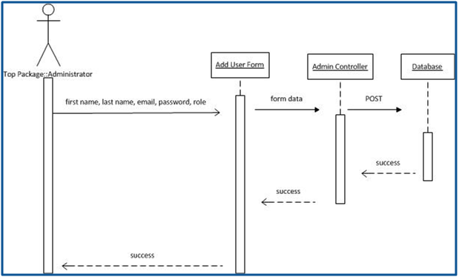
User Story #2 - Add User
Notes:
20 seconds
The tile of user story
Please present and show the complexity of your work, code, algorithms, and technical challenges and technologies you have used. (you could use screenshot if you want. Visual presentations are better than text presentation) - Go into the details of the most important/significant tasks using bullet lists or visual graphs or state chart diagram - Demo using screenshots or GIF (in another separate page if required)
Sequence Diagram for this user story is optional

Slide 17
User Story #2 - Add User
Notes:
20 seconds
The tile of user story
Please present and show the complexity of your work, code, algorithms, and technical challenges and technologies you have used. (you could use screenshot if you want. Visual presentations are better than text presentation) - Go into the details of the most important/significant tasks using bullet lists or visual graphs or state chart diagram - Demo using screenshots or GIF (in another separate page if required)
Sequence Diagram for this user story is optional

Slide 18
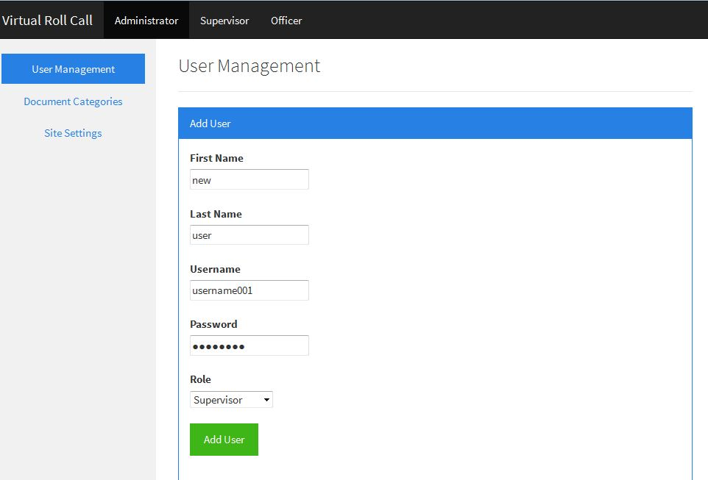
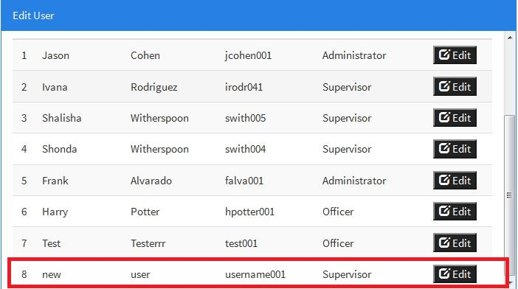
User Story #2 - Add User
Notes:
20 seconds
The tile of user story
Please present and show the complexity of your work, code, algorithms, and technical challenges and technologies you have used. (you could use screenshot if you want. Visual presentations are better than text presentation) - Go into the details of the most important/significant tasks using bullet lists or visual graphs or state chart diagram - Demo using screenshots or GIF (in another separate page if required)
Sequence Diagram for this user story is optional

Slide 19
User Story #3 - Change Password
As a user, I would like the ability to change my password so that I can protect the privacy of my credentials.
Precondition: This use case assumes that the user is logged in and on the change password page
Actor interaction: User | System response: VRC App
1. TUCBW the user entering their current password, a new password, and a password confirmation in the form input fields | 2. The system updates the user’s password and notifies the user accordingly
3. The user’s password is updated in the system
Postcondition: The user’s password is updated in the system and will need to use the new password to access the system again.
Notes:
20 seconds
The tile of user story
Please present and show the complexity of your work, code, algorithms, and technical challenges and technologies you have used. (you could use screenshot if you want. Visual presentations are better than text presentation) - Go into the details of the most important/significant tasks using bullet lists or visual graphs or state chart diagram - Demo using screenshots or GIF (in another separate page if required)
Sequence Diagram for this user story is optional

Slide 20
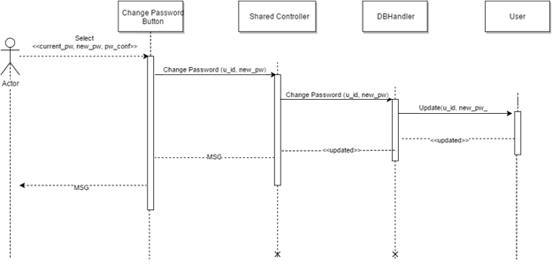
User Story #3 - Change Password
Notes:
20 seconds
The tile of user story
Please present and show the complexity of your work, code, algorithms, and technical challenges and technologies you have used. (you could use screenshot if you want. Visual presentations are better than text presentation) - Go into the details of the most important/significant tasks using bullet lists or visual graphs or state chart diagram - Demo using screenshots or GIF (in another separate page if required)
Sequence Diagram for this user story is optional

Slide 21
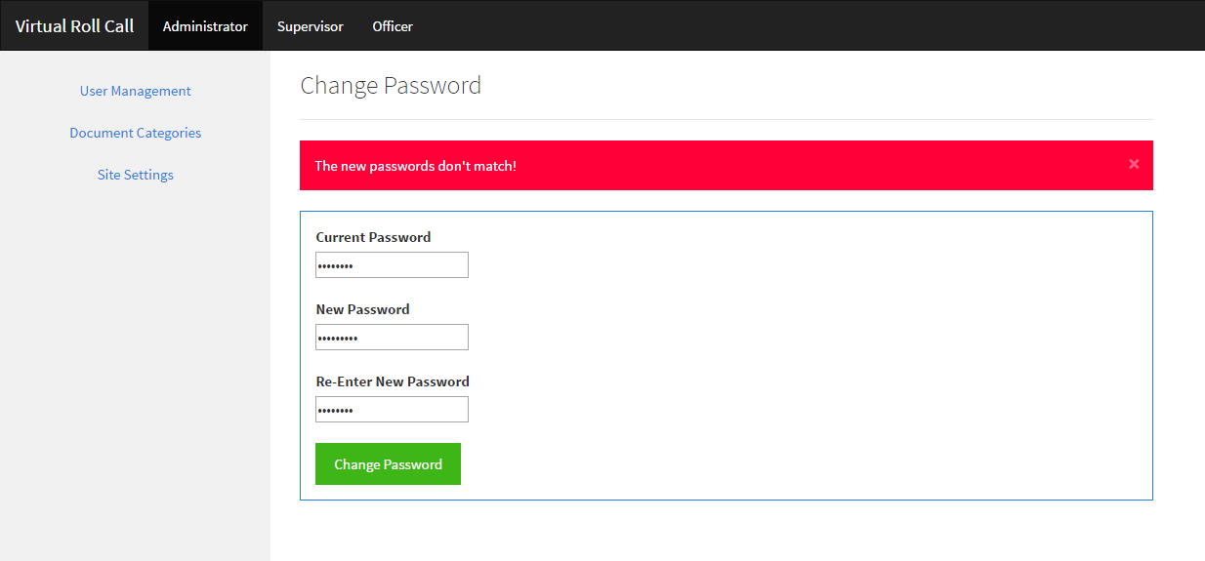
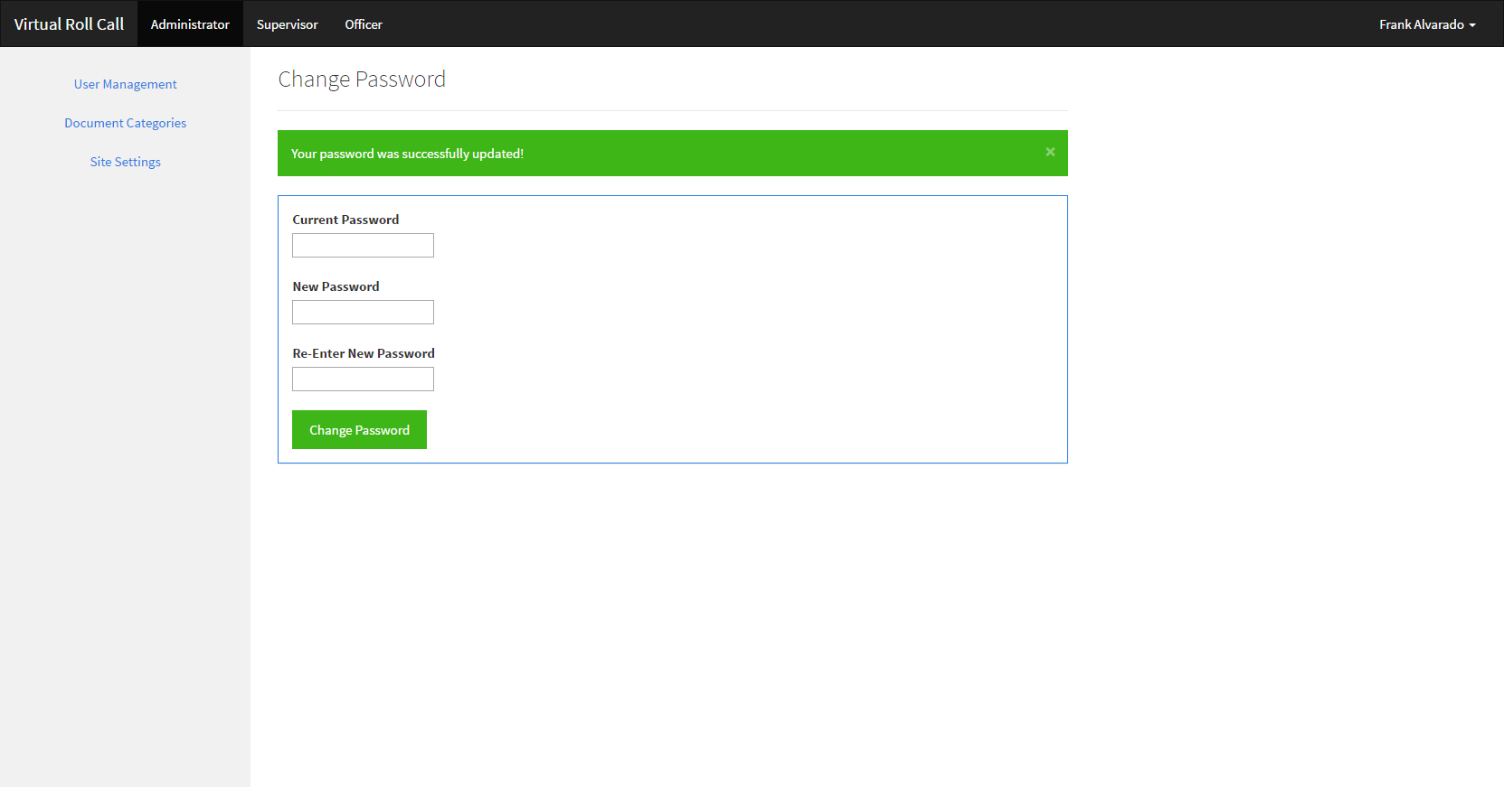
User Story #3 - Change Password
Notes:
20 seconds
The tile of user story
Please present and show the complexity of your work, code, algorithms, and technical challenges and technologies you have used. (you could use screenshot if you want. Visual presentations are better than text presentation) - Go into the details of the most important/significant tasks using bullet lists or visual graphs or state chart diagram - Demo using screenshots or GIF (in another separate page if required)
Sequence Diagram for this user story is optional

Slide 22
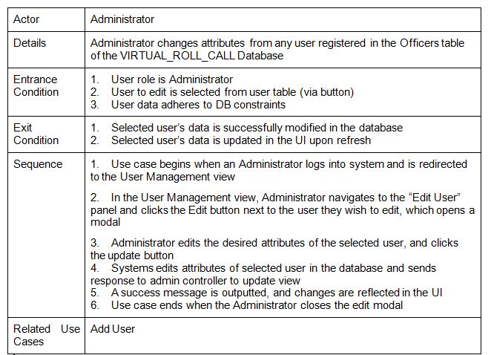
User Story #4 - Edit User
As an administrator, I would like the ability to edit user data so that I can update any changes about a given user.

Slide 23
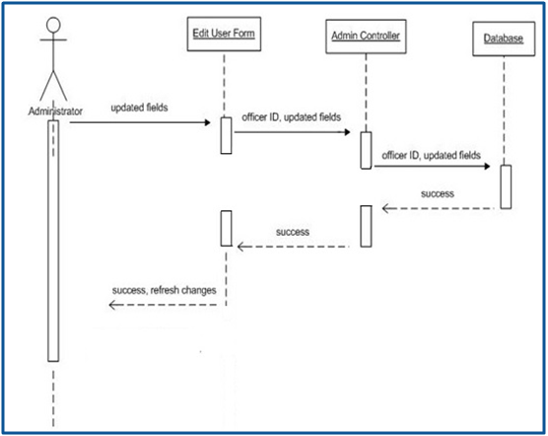
User Story #4 - Edit User

Slide 24
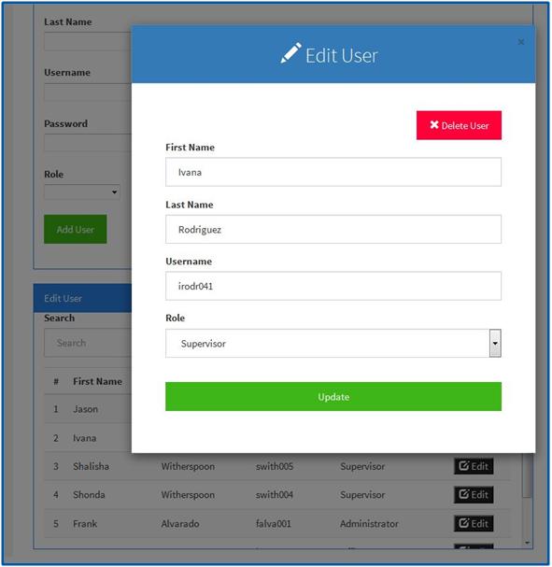
User Story #4 - Edit User

Slide 25
User Story #5 - Remove User
As an administrator, I would like to be able to remove other users from the database, so that they may no longer access the system.
Actor | Administrator
Details | Removes user from system
Entrance conditions | User role is administrator User to be removed has login credentials
Exit condition | User is no longer authenticated to login to the system
Sequence | 1. Use case begins when an Administrator logs into system and is redirected to the User Management view 2. In the User Management view, admin navigates to the “Edit User” panel and clicks the Edit button next to the user they wish to edit, which opens a modal 3. Admin clicks the Delete User button located at the top right corner of the modal 4. Admin confirms whether they would like to delete the selected user in the confirmation dialog box 5. System removes user from database and sends response to admin controller to update view 6. Use case ends when admin confirms and selected user is removed from the Edit User panel
Notes:
20 seconds
The tile of user story
Please present and show the complexity of your work, code, algorithms, and technical challenges and technologies you have used. (you could use screenshot if you want. Visual presentations are better than text presentation) - Go into the details of the most important/significant tasks using bullet lists or visual graphs or state chart diagram - Demo using screenshots or GIF (in another separate page if required)
Sequence Diagram for this user story is optional

Slide 26
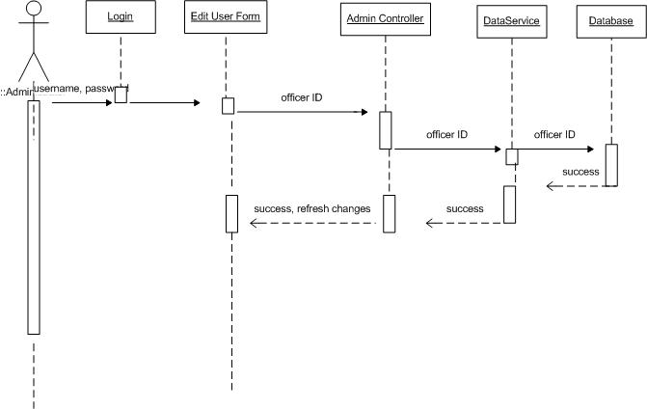
Sequence Diagram

Slide 27
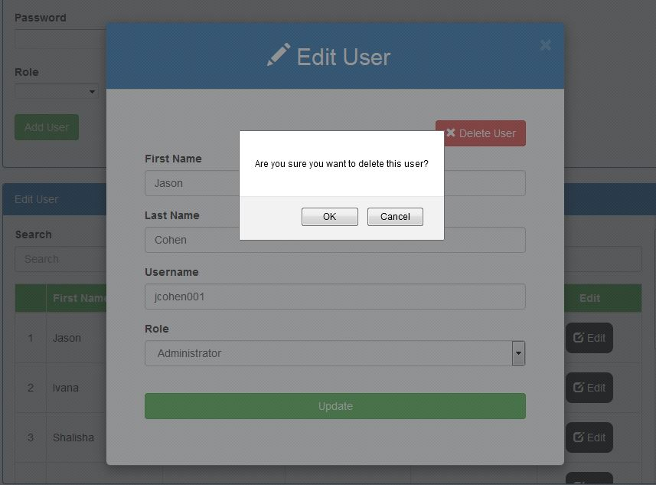

Slide 28
User Story #6 - Reset Password
As a supervisor, I would like the ability to reset passwords for locked users so that they can regain access to the system.
Precondition: This use case assumes that the supervisor has already logged in and that a user has approached the supervisor to unlock his or her account by resetting their password.
Actor interaction: Supervisor | System response: VRC App
1. TUCBW the supervisor selecting the “Reset Password” link in the dashboard navigation. | 2. The system routes the supervisor to the appropriate view.
3. The supervisor uses the search functionality to find the locked user in question, if need be. | 4. The system filters the list of users accordingly until a desired user is found.
5. The user selects the locked user by marking the radio button for the appropriate row. | 6. The system enables the password and password confirmation fields in the table.
7. The supervisor enters a password in the “New Password” field.
7b. The supervisor enters the same password in the “Password Confirmation” field.
7c. The supervisor selects the “Reset” link. | 8. The system resets the locked user’s password and notifies the user accordingly.
9. The supervisor has successfully reset the locked user’s password.
Postcondition: The locked user has had his or her password successfully reset and can now log into the system using their new password.
Notes:
20 seconds
The tile of user story
Please present and show the complexity of your work, code, algorithms, and technical challenges and technologies you have used. (you could use screenshot if you want. Visual presentations are better than text presentation) - Go into the details of the most important/significant tasks using bullet lists or visual graphs or state chart diagram - Demo using screenshots or GIF (in another separate page if required)
Sequence Diagram for this user story is optional

Slide 29
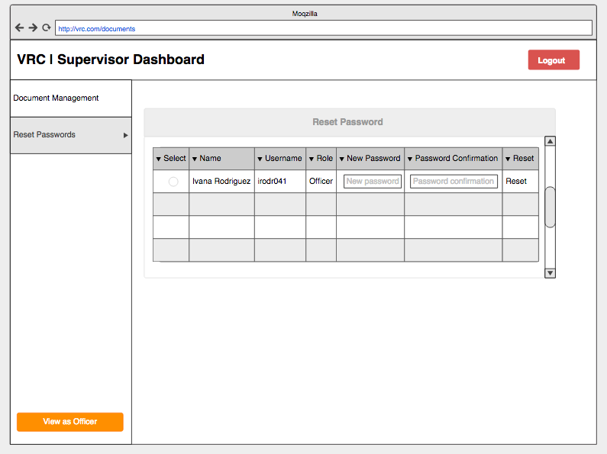
User Story #6 - Reset Password
Notes:
20 seconds
The tile of user story
Please present and show the complexity of your work, code, algorithms, and technical challenges and technologies you have used. (you could use screenshot if you want. Visual presentations are better than text presentation) - Go into the details of the most important/significant tasks using bullet lists or visual graphs or state chart diagram - Demo using screenshots or GIF (in another separate page if required)
Sequence Diagram for this user story is optional

Slide 30
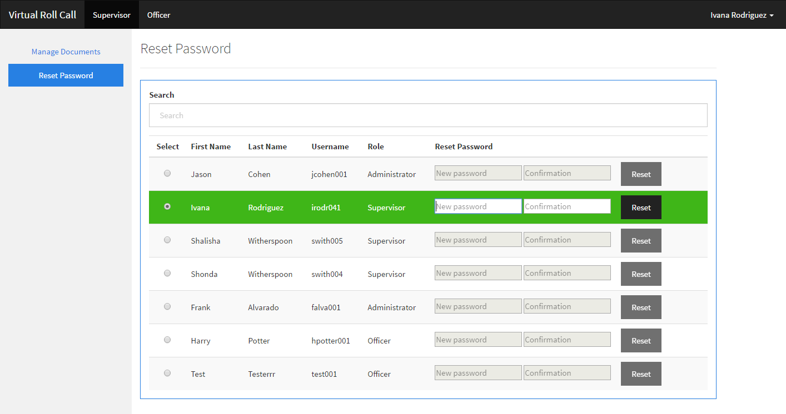
User Story #6 - Reset Password
Notes:
20 seconds
The tile of user story
Please present and show the complexity of your work, code, algorithms, and technical challenges and technologies you have used. (you could use screenshot if you want. Visual presentations are better than text presentation) - Go into the details of the most important/significant tasks using bullet lists or visual graphs or state chart diagram - Demo using screenshots or GIF (in another separate page if required)
Sequence Diagram for this user story is optional

Slide 31
User Story #7 - Add Category
As an administrator, I would like the ability to add new categories to the officer view, so that documents are able to be sorted in a more appropriate category.
Precondition: This use case assumes that the administrator has already logged in.
Actor interaction: Administrator | System response: VRC App
1. TUCBW the administrator selecting the “Document Categories” link in the dashboard navigation. | 2. The system routes the administrator to the appropriate view.
3. The administrator enters a category in the category field and clicks that ‘Add’ button. | 4. The system adds the category to the database.
5. The category is now listed under existing categories.
Postcondition: The category is now viewable by the administrator, supervisor, and officer.
Notes:
20 seconds
The tile of user story
Please present and show the complexity of your work, code, algorithms, and technical challenges and technologies you have used. (you could use screenshot if you want. Visual presentations are better than text presentation) - Go into the details of the most important/significant tasks using bullet lists or visual graphs or state chart diagram - Demo using screenshots or GIF (in another separate page if required)
Sequence Diagram for this user story is optional

Slide 32
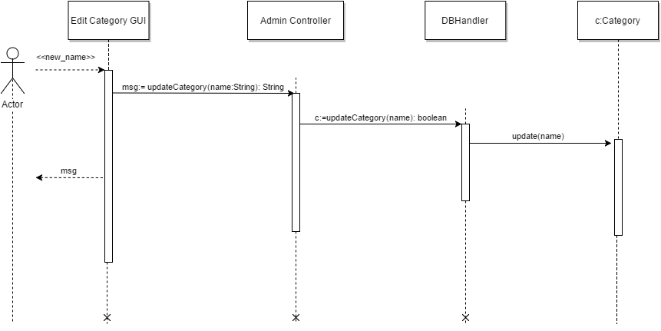
User Story #7 - Add Category
Notes:
20 seconds
The tile of user story
Please present and show the complexity of your work, code, algorithms, and technical challenges and technologies you have used. (you could use screenshot if you want. Visual presentations are better than text presentation) - Go into the details of the most important/significant tasks using bullet lists or visual graphs or state chart diagram - Demo using screenshots or GIF (in another separate page if required)
Sequence Diagram for this user story is optional

Slide 33
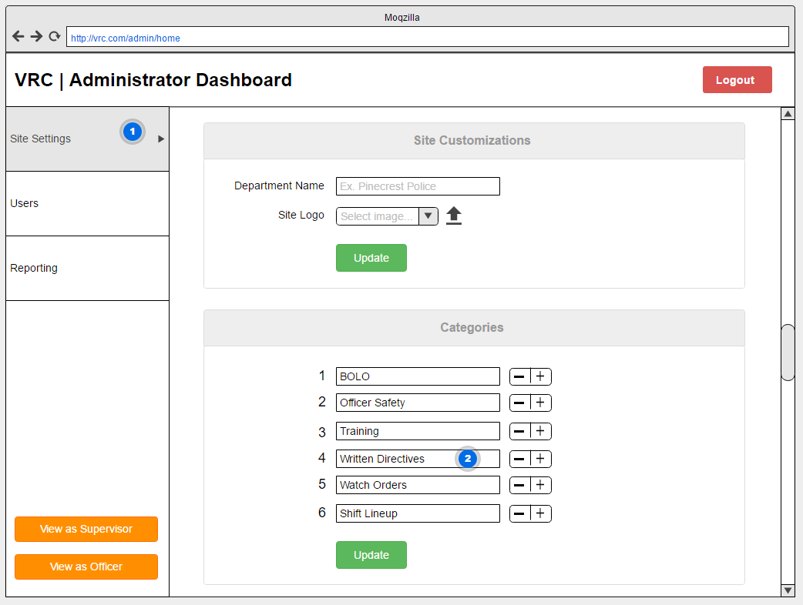
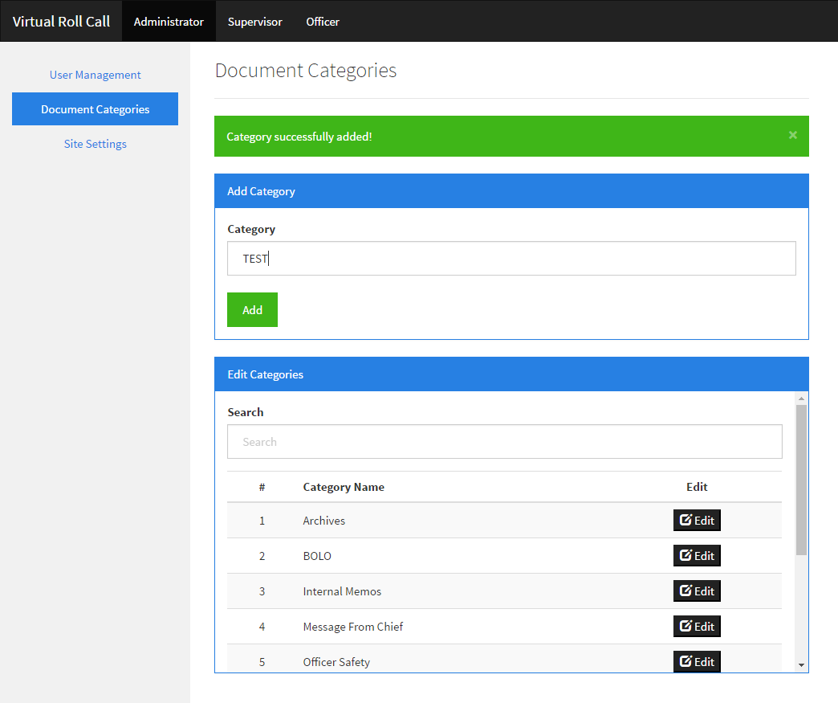
User Story #7 - Add Category
Mockup
Realization
Notes:
20 seconds
The tile of user story
Please present and show the complexity of your work, code, algorithms, and technical challenges and technologies you have used. (you could use screenshot if you want. Visual presentations are better than text presentation) - Go into the details of the most important/significant tasks using bullet lists or visual graphs or state chart diagram - Demo using screenshots or GIF (in another separate page if required)
Sequence Diagram for this user story is optional

Slide 34
User Story #8 - Add Document
As a supervisor, I would like to add Document metadata to the database, so I can view detailed information about each document.
Actor | Supervisor
Details | Adds Document metadata to the Database
Entrance conditions | User role is Supervisor Supervisor enters Document metadata in the form
Exit condition | Document metadata is added to the system
Sequence | 1. Use case begins when an Supervisor logs into system and is redirected to the Manage Documents view 2. In the Manage Documents view, admin navigates to the “Upload Documents” panel and selects document to upload, and enters metadata for file 3. Admin clicks the Upload button 4. System adds documents metadata to the DB 5. Use case ends when clicks Upload button and uploaded document metadata is added to Edit Documents panel table
Related Use Cases | Upload Document
Notes:
20 seconds
The tile of user story
Please present and show the complexity of your work, code, algorithms, and technical challenges and technologies you have used. (you could use screenshot if you want. Visual presentations are better than text presentation) - Go into the details of the most important/significant tasks using bullet lists or visual graphs or state chart diagram - Demo using screenshots or GIF (in another separate page if required)
Sequence Diagram for this user story is optional

Slide 35
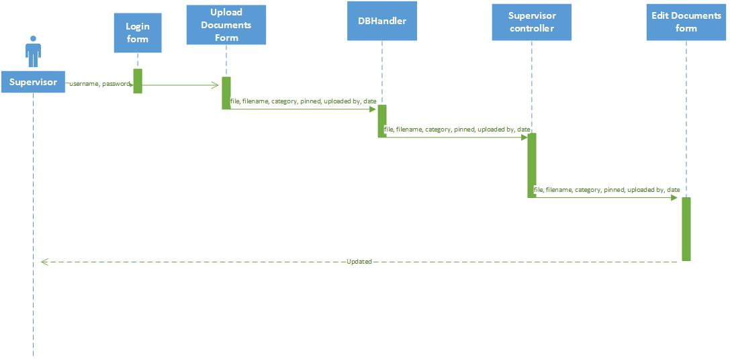
Sequence Diagram

Slide 36
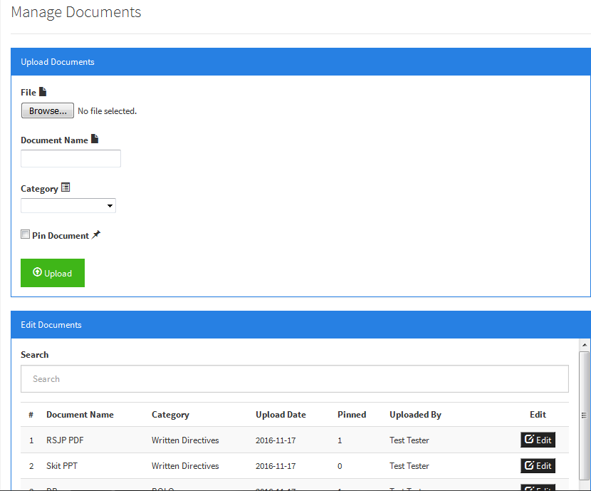

Slide 37
User Story #9 - Edit Category
As an administrator, I want the ability to edit the category names that documents will be uploaded into so that I can customize the application for my department.
Precondition: This use case assumes that the administrator has already logged in.
Actor interaction: Administrator | System response: VRC App
1. TUCBW the administrator selecting the “Document Categories” link in the dashboard navigation. | 2. The system routes the administrator to the appropriate view.
3. The administrator selects the ‘Edit’ button for the category he/she would like to edit. | 4. The system opens a modal with and editable field for the selected category name.
5. The administrator modifies the name of the category and selects ‘Update’. | 6. The system saves the new name in the database.
7. The new name appears in the list of existing categories.
Postcondition: The edited category is now viewable by the administrator, supervisor, and officer.
Notes:
20 seconds
The tile of user story
Please present and show the complexity of your work, code, algorithms, and technical challenges and technologies you have used. (you could use screenshot if you want. Visual presentations are better than text presentation) - Go into the details of the most important/significant tasks using bullet lists or visual graphs or state chart diagram - Demo using screenshots or GIF (in another separate page if required)
Sequence Diagram for this user story is optional

Slide 38
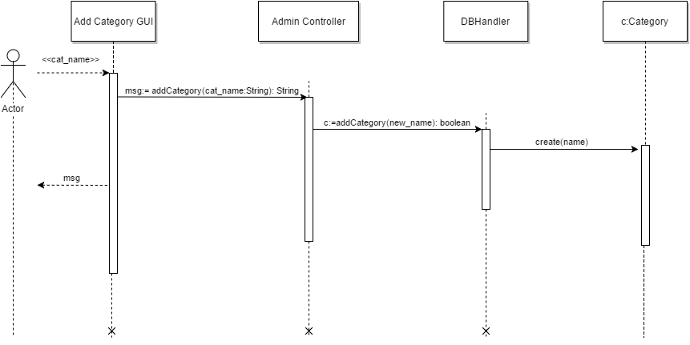
User Story #9 - Edit Category
Notes:
20 seconds
The tile of user story
Please present and show the complexity of your work, code, algorithms, and technical challenges and technologies you have used. (you could use screenshot if you want. Visual presentations are better than text presentation) - Go into the details of the most important/significant tasks using bullet lists or visual graphs or state chart diagram - Demo using screenshots or GIF (in another separate page if required)
Sequence Diagram for this user story is optional

Slide 39
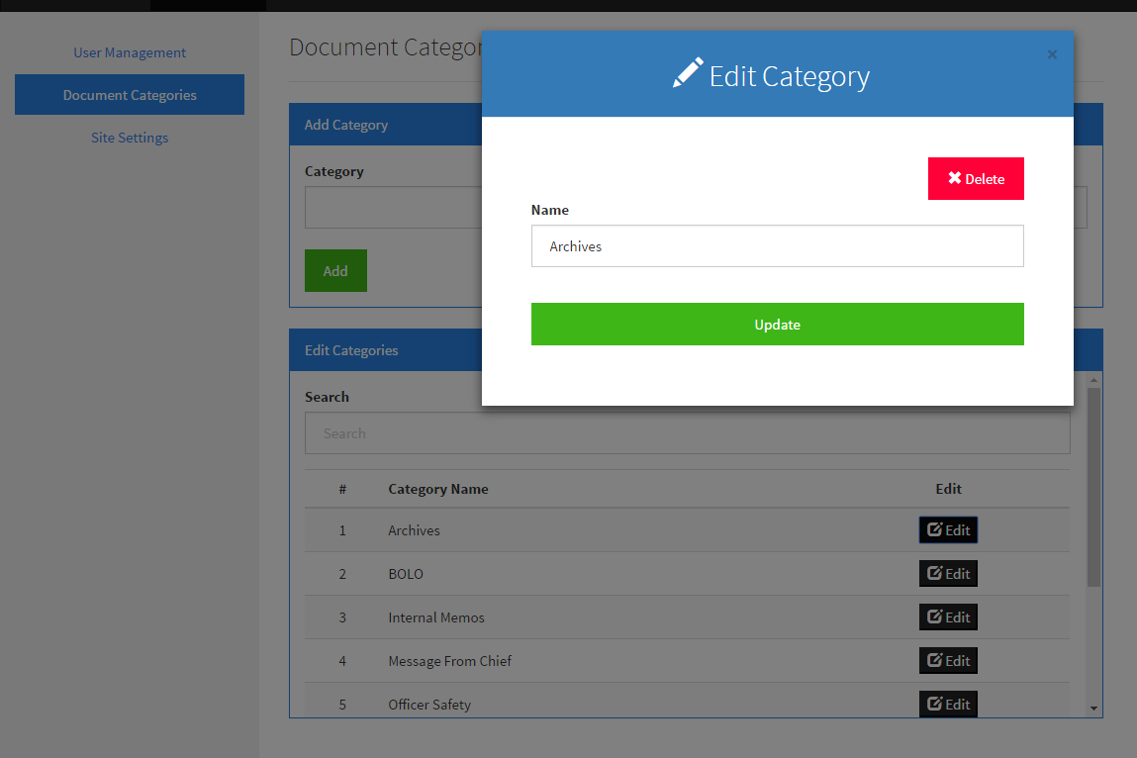
User Story #9 - Edit Category
Notes:
20 seconds
The tile of user story
Please present and show the complexity of your work, code, algorithms, and technical challenges and technologies you have used. (you could use screenshot if you want. Visual presentations are better than text presentation) - Go into the details of the most important/significant tasks using bullet lists or visual graphs or state chart diagram - Demo using screenshots or GIF (in another separate page if required)
Sequence Diagram for this user story is optional

Slide 40
User Story #10 - Remove Category
As an Administrator, I would like the ability to remove categories from the system, so that documents can no longer be associated with the chosen category.
Actor | Administrator
Details | Removes Category from system
Entrance conditions | User role is Supervisor Supervisor navigates to Site Settings view
Exit condition | Category is removed from system
Sequence | 1. Use case begins when an Administrator clicks the Edit Category button, which opens a modal 2. Admin clicks the Delete Category button located at the top right corner of the modal 3. Admin confirms whether they would like to delete the selected category in the confirmation dialog box 4. System removes category from database and sends response to admin controller to update view 5. Use case ends when admin confirms and selected category is removed from the Edit Category panel
Related Use Cases | Edit Category
Notes:
20 seconds
The tile of user story
Please present and show the complexity of your work, code, algorithms, and technical challenges and technologies you have used. (you could use screenshot if you want. Visual presentations are better than text presentation) - Go into the details of the most important/significant tasks using bullet lists or visual graphs or state chart diagram - Demo using screenshots or GIF (in another separate page if required)
Sequence Diagram for this user story is optional

Slide 41
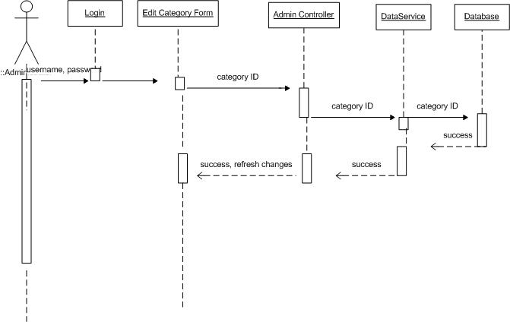
Sequence Diagram

Slide 42
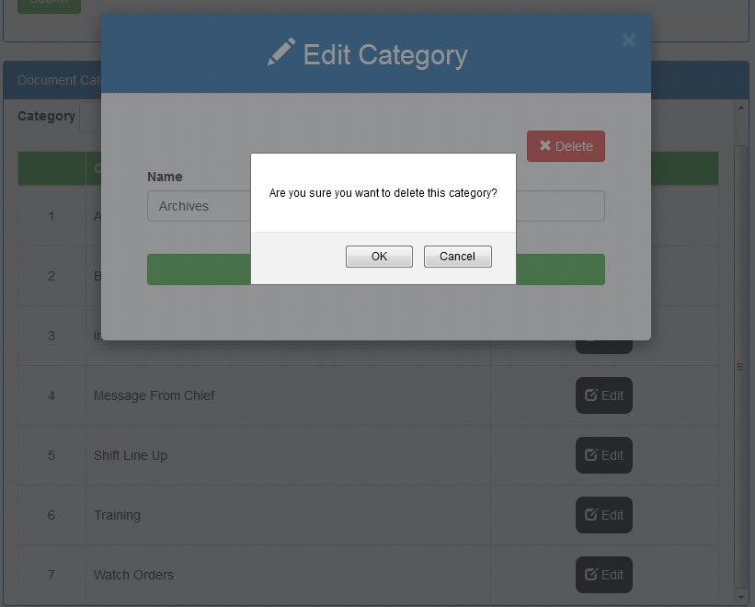

Slide 43
User Story #11 - Upload Document
As a supervisor, I would like to be able to upload documents to the server, so that officers can later view these documents in their appropriate categories folder
Actor | Supervisor
Details | Supervisor adds a document to the server, which will late be viewed by officers
Entrance Condition | User role is supervisor User has document to upload
Exit Condition | Document is added to the server
Sequence | Use case begins when a supervisor logs into the system From the Manage Documents page, in the upload documents page, user enters document to upload after pressing browse button, and sets other attributes (such as category, and document name) Supervisor clicks upload button to initiate the upload of the file to the server Use case ends after document is successfully uploaded, and appears in the uploads directory of the developer server

Slide 44
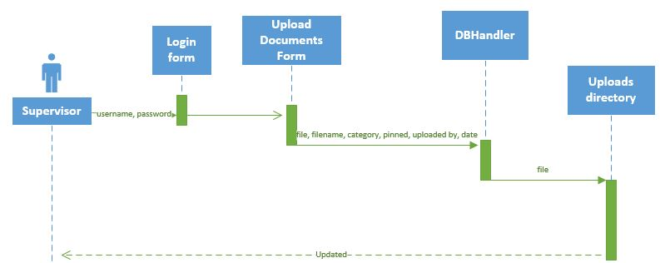
User Story #11 - Upload Document

Slide 45
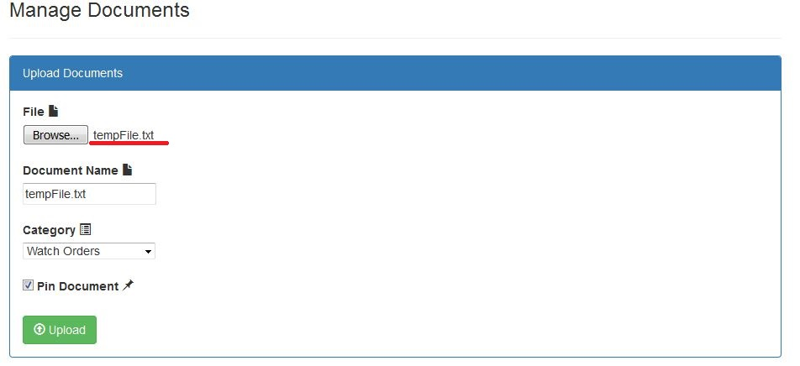
User Story #11 - Upload Document

Slide 46
User Story #12 -
Customize Site Settings
As an administrator, I would like the ability to customize the department logo, application’s name, and the department’s name so that I can tailor the application to my police department’s needs.
Precondition: This use case assumes that the administrator has already logged in and on the site settings page.
Actor interaction: Administrator | System response: VRC App
1. TUCBW the administrator selecting the ‘Select image’ button. | 2. The system opens a dialog box and prompts the administrator to select an image on their machine.
3. The administrator selects an image and selects ‘Ok’. | 4. The system displays the selected image in the panel.
5. The administrator selects ‘Save’ to save the image. | 6. The system saves the image and notifies the user accordingly.
7. The new logo reflects on the login page and persists even after the session ends.
Postcondition: The changes made reflect on the rest of the site.
Notes:
20 seconds
The tile of user story
Please present and show the complexity of your work, code, algorithms, and technical challenges and technologies you have used. (you could use screenshot if you want. Visual presentations are better than text presentation) - Go into the details of the most important/significant tasks using bullet lists or visual graphs or state chart diagram - Demo using screenshots or GIF (in another separate page if required)
Sequence Diagram for this user story is optional

Slide 47
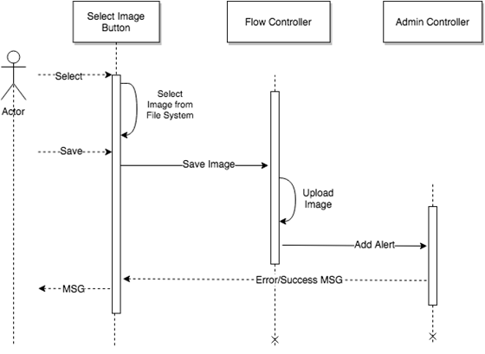
User Story #12 -
Customize Site Settings
Notes:
20 seconds
The tile of user story
Please present and show the complexity of your work, code, algorithms, and technical challenges and technologies you have used. (you could use screenshot if you want. Visual presentations are better than text presentation) - Go into the details of the most important/significant tasks using bullet lists or visual graphs or state chart diagram - Demo using screenshots or GIF (in another separate page if required)
Sequence Diagram for this user story is optional

Slide 48
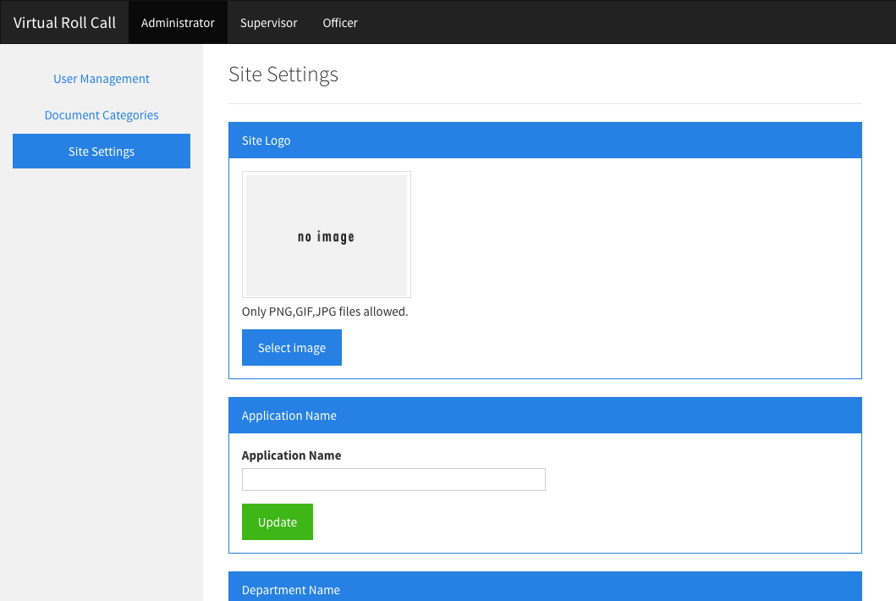
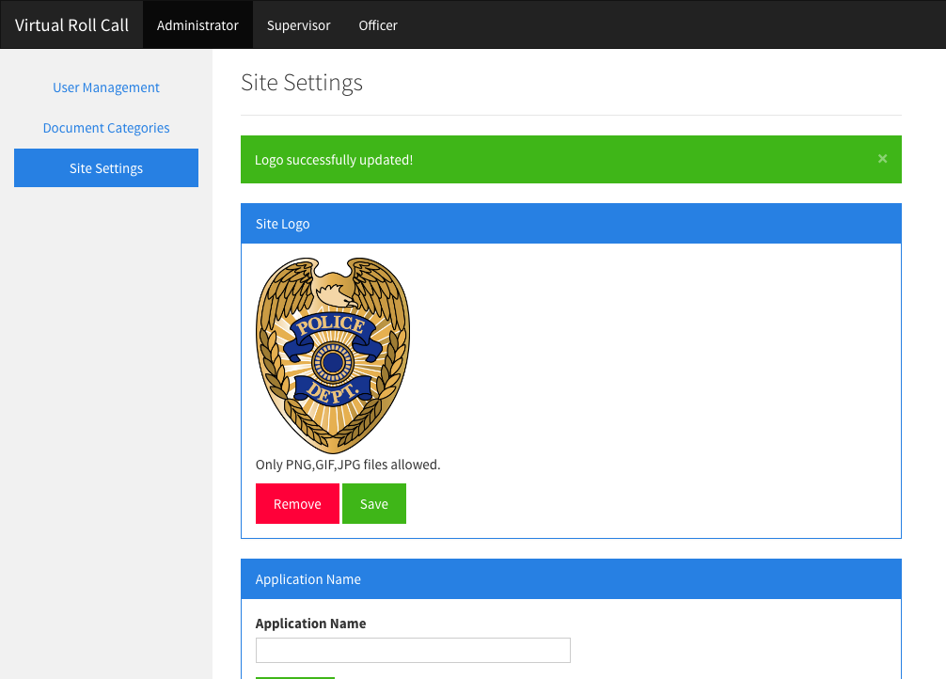
User Story #12 -
Customize Site Settings
Notes:
20 seconds
The tile of user story
Please present and show the complexity of your work, code, algorithms, and technical challenges and technologies you have used. (you could use screenshot if you want. Visual presentations are better than text presentation) - Go into the details of the most important/significant tasks using bullet lists or visual graphs or state chart diagram - Demo using screenshots or GIF (in another separate page if required)
Sequence Diagram for this user story is optional

Slide 49
User Story #13 - List Pinned Documents
As an Officer, I would like to see the list of pinned documents, so that I can know the most important documents that my supervisor would like for me to view
Actor | Officer
Details | List pinned documents in the database (filtered by category)
Entrance conditions | User selects category to view documents in their dashboard
Exit condition | User is able to view list of pinned documents
Sequence | 1. Use case begins when an Supervisor logs into system 2. Officer clicks category to view documents under 3. Use case ends when officer is able to view pinned documents on top of page based on selected category
Related Use Cases | List unpinned documents
Notes:
20 seconds
The tile of user story
Please present and show the complexity of your work, code, algorithms, and technical challenges and technologies you have used. (you could use screenshot if you want. Visual presentations are better than text presentation) - Go into the details of the most important/significant tasks using bullet lists or visual graphs or state chart diagram - Demo using screenshots or GIF (in another separate page if required)
Sequence Diagram for this user story is optional

Slide 50
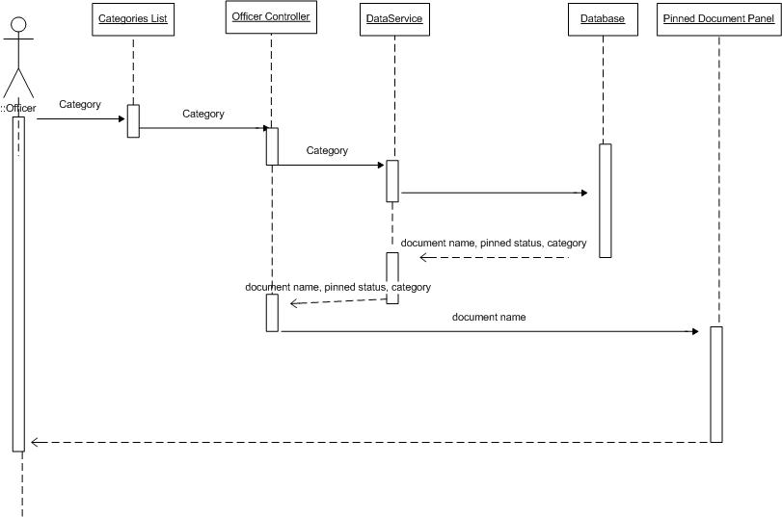
Sequence Diagram

Slide 51
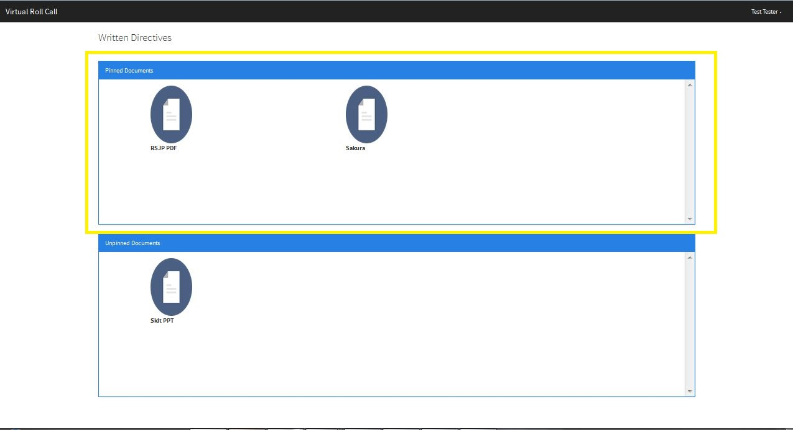

Slide 52
User Story #14 - List Unpinned Documents
As an officer, I would like to view the list of unpinned documents separately from pinned documents, so that I know the documents of least importance.
Actor | Officer
Details | List pinned documents in the database (filtered by category)
Entrance conditions | User is logged on to officer role Officer navigates to chosen category to view documents under
Exit condition | Officer is able to view list of unpinned documents
Sequence | 1. Use case begins when an Supervisor logs into system 2. Officer clicks category to view documents under 3. Use case ends when officer is able to view unpinned documents on bottom of page based on selected category
Related Use Cases | List pinned documents
Notes:
20 seconds
The tile of user story
Please present and show the complexity of your work, code, algorithms, and technical challenges and technologies you have used. (you could use screenshot if you want. Visual presentations are better than text presentation) - Go into the details of the most important/significant tasks using bullet lists or visual graphs or state chart diagram - Demo using screenshots or GIF (in another separate page if required)
Sequence Diagram for this user story is optional

Slide 53
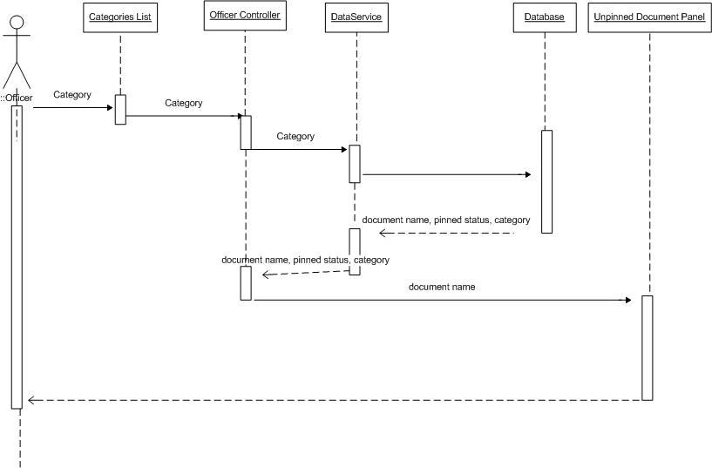
Sequence Diagram

Slide 54
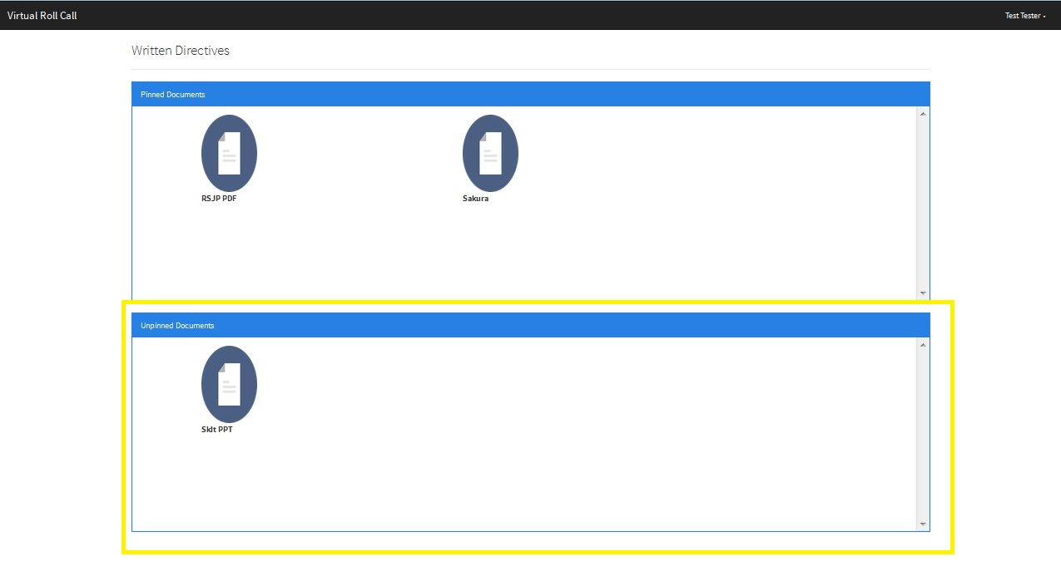

Slide 55
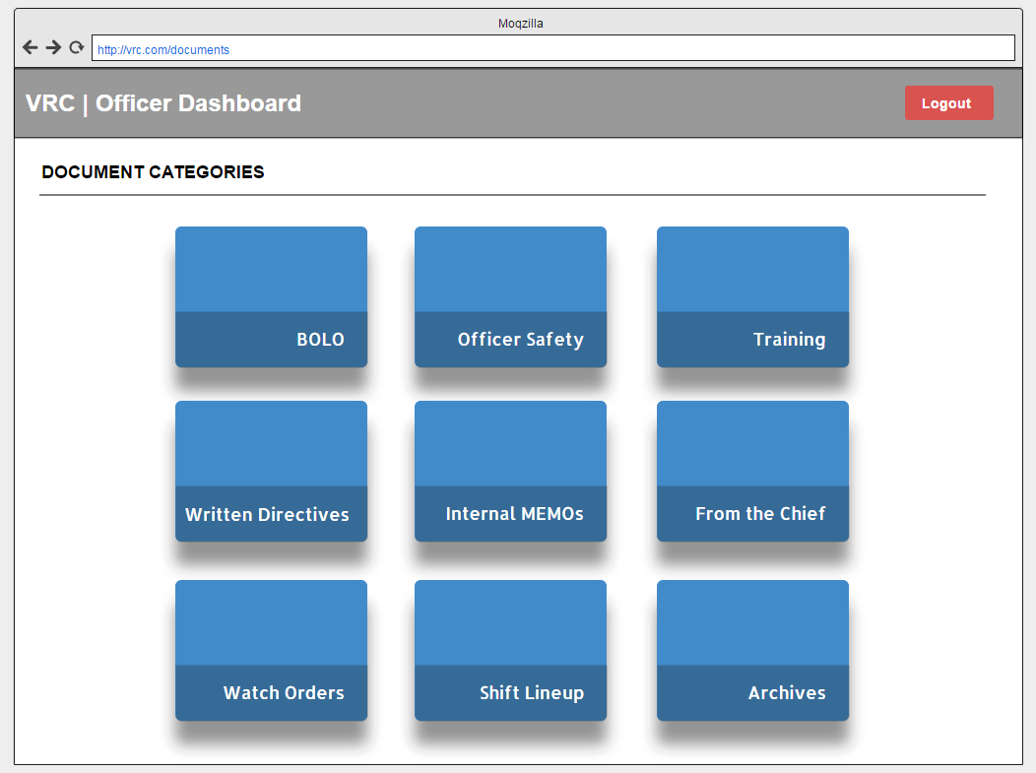
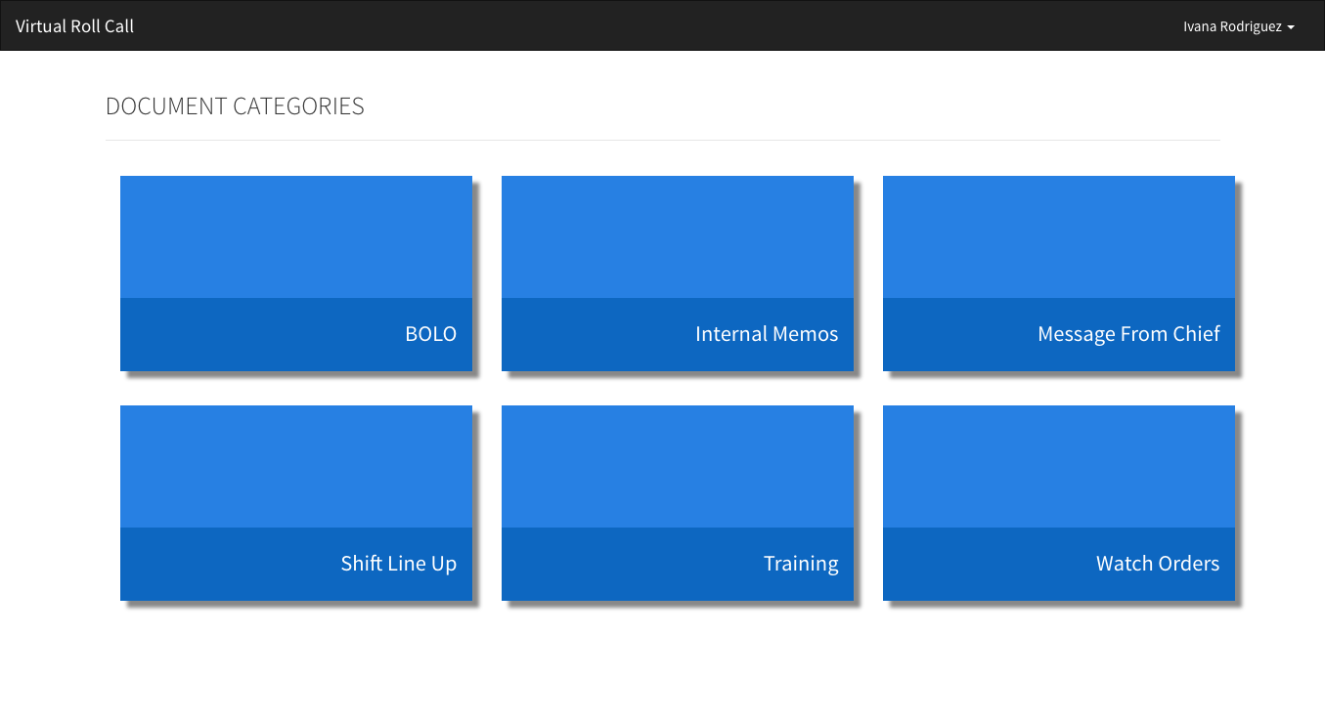
User Story #15 - View Categories
As an officer, I want to be able to view all of the document categories in one page so that I can drill down to a specific category.
Mockup
Realization
Notes:
20 seconds
The tile of user story
Please present and show the complexity of your work, code, algorithms, and technical challenges and technologies you have used. (you could use screenshot if you want. Visual presentations are better than text presentation) - Go into the details of the most important/significant tasks using bullet lists or visual graphs or state chart diagram - Demo using screenshots or GIF (in another separate page if required)
Sequence Diagram for this user story is optional

Slide 56
User Story #16 - View Documents
As an officer, I would like to view documents in a given category, so that I can be informed of important and relevant documents for each specific category
Actor | Officer
Details | Officer can open or download documents stored in the DOCUMENTS table of the VIRTUAL_ROLL_CALL Database
Entrance Condition | 1. User role is Officer 2. Officer clicks on a category that has reference to documents
Exit Condition | 1. Officer clicks on the file icon and views or downloads the file
Sequence | 1. Use case begins when an officer logs into system and is redirected to the Category Selection view 2. In the Category Selection view, the officer navigates clicks on a category for the type of document they wish to view 3. Officer clicks on a file icon, and is prompted to view or download the file 4. Use case ends when the Administrator closes the edit modal

Slide 57
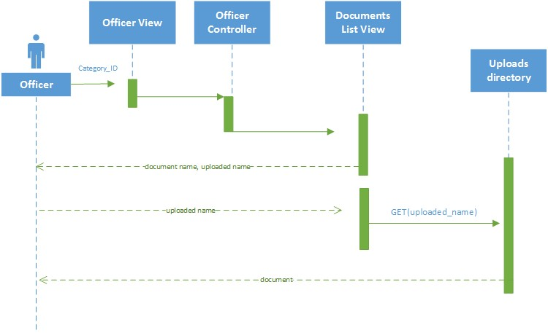
User Story #16 - View Documents

Slide 58
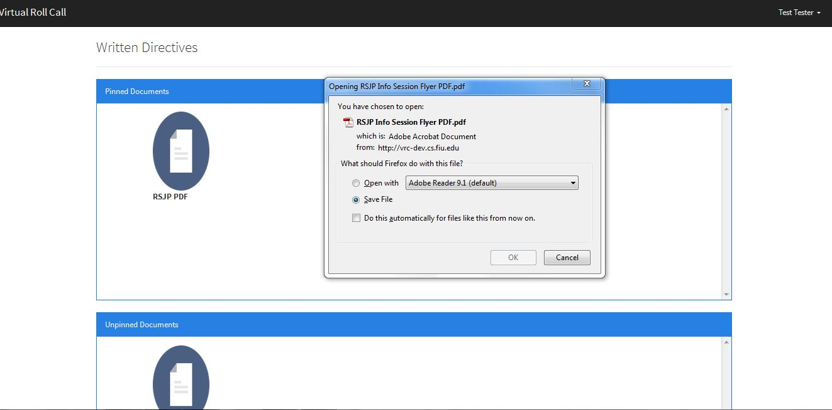
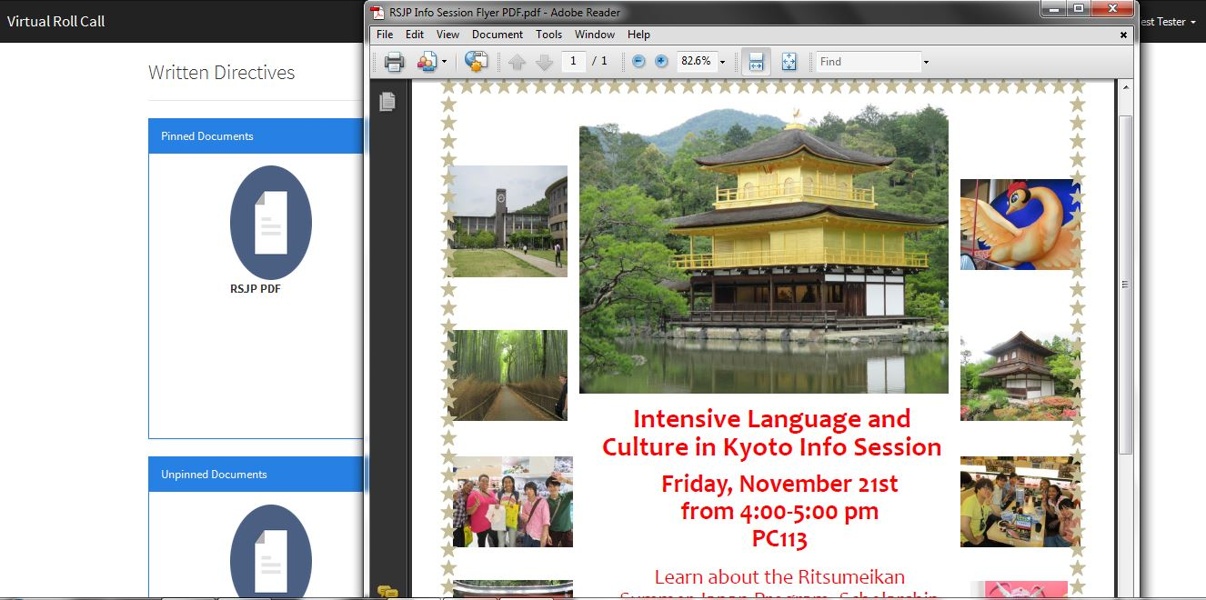
User Story #16 - View Documents

Slide 59
Unit Test Example: Edit User
This section details the unit test cases that were used to validate the features completed during each sprint. Each use case unit test consist of a sunny day and rainy day scenario, as well as an integration test to ensure the functionality of previous implementations remains intact.
Sunny Day
Rainy Day
Purpose | Verify that user’s attributes are edited in the database, and reflects the data the Administrator inputted in the edit modal
Entrance Condition | 1. User role is Administrator 2. User to edit is selected from user table (via button) 3. User data adheres to DB constraints
Input | The selected user’s first name, last name, username, and role in the system
Expected Output | Success Message. Selected user’s attributes edited in the Database and changes are reflected in UI (Edit User panel table)
Purpose | Verify that Administrator cannot successfully data that violates DB constraints (such as duplicate username) and receive a success message
Entrance Condition | 1. User role is Administrator 2. User to edit is selected from user table (via button) 3. User data adheres to DB constraints
Input | User enters a username already in the database
Expected Output | Edit is denied, and user’s attributes do not update
Notes:
(Shalisha)
10 seconds
A description of verification process and Test Suites and Test Cases for one of the use cases.
1 One sunny day and one rainy day for the implemented use cases (one or more slides).
2 Automated test scripts for the implemented use cases (if any) (one or more slides).

Slide 60

Integration Test
Purpose | Verify that edited fields (such as first and/or last name) are reflected in user log in
Entrance Condition | User role is Administrator, Supervisor, or Officer
Expected Outcome | User login has updated first and/or last name

Slide 61



Summary
Conclusion
Our effort in implementing the first version of Virtual Roll Call, and successfully developing key features will ensure that officers are always up to date on the latest briefings, and can carry out their tasks efficiently, which will be a great service to the whole community.
Contact
Ivana Rodriguez (irodr041@fiu.edu)
Shalisha Witherspoon (swith005@fiu.edu)
Shonda Witherspoon (swith004@fiu.edu)
Questions?
Thank You!
Notes:
Ivana, Shalisha (summary)
Summarize your contribution, mention your effort for Scrum, Mingle, Github, Google Drive Documentation and minutes
Include your contact information
Ask if anyone has any questions for you.
Thank your audience

